Slide 1
Idea presentation
Domain
Use cases & Functionalities
Technologies
Data
Group 1.
Mahmut, Isac, Sebastian, Célian, Clément.

Slide 2

Pharmaceutical Risk Interaction and Safety Monitor

Slide 3
Domain
Pharmaceutical Safety and Drug Interaction Management
Notes:
The domain of your application is Pharmaceutical Safety and Drug Interaction Management.
This encompasses the assessment of medication safety, side effects, drug interactions, and the recommendation of alternative medications in a healthcare setting.

Slide 4
Use Cases & Functionalities
1. Side Effect Identification
identify_side_effects(proposed_medication, current_medications) -> side_effects
2. Alternative Medication Suggestions
suggest_alternative_medications(proposed_medication, side_effects) -> alternative_medications
3. Condition-Based Medication Recommendations
recommend_medications(current_medications, medical_conditions) -> recommended_medications
4. Current Medication Adjustment
adjust_medications(current_medications, required_medication) -> adjusted_medication_plan

Slide 5
Technologies
Large Language Models
SPARQL
Python

Slide 6

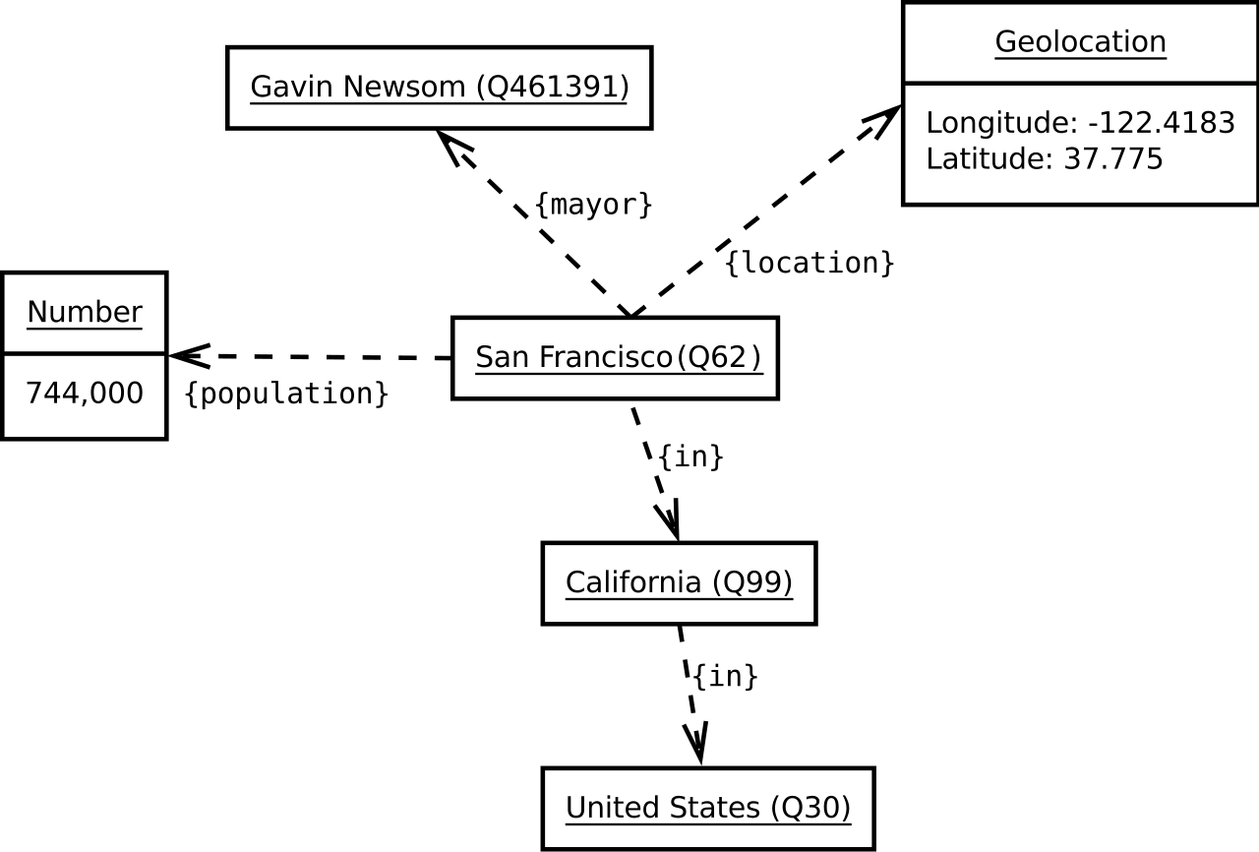
DATA
wikidata
Wikidata.org is a free, collaborative knowledge base for structured data
Data is structures in item-property-value triplets, equivalent to subject-predicate-object.

Slide 7
THE END

